Slide 1



CPD Multi Skills April 2020 By K Clarke
Multi Skills is about pupils learning the fundamental movement skills of balance, speed, agility and movement. The aim is to progress your teaching as the pupils are older to a more child centred approach where the pupils learn at their own pace, whilst having fun.
Furthermore, they do the activities with their friends and mix with their fellow peers to enhance their social needs of team work, communication and problem solving.

Slide 2
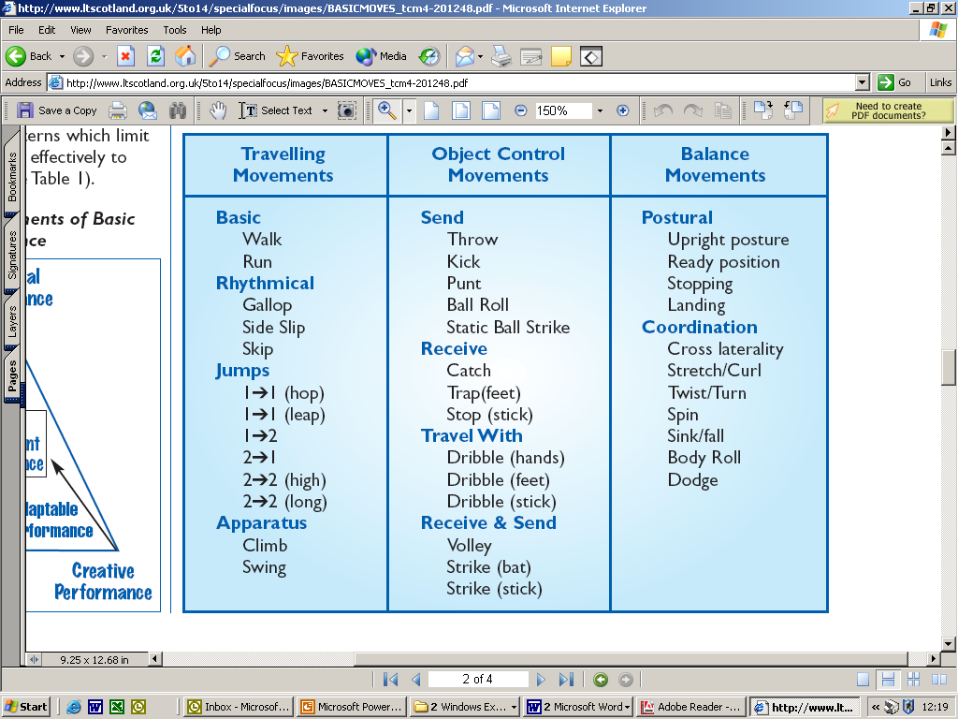
FUNdamentals All of the below skills will vary from pupil to pupil but they should be encouraged to work at their own pace and hopefully develop resilience skills whilst having fun.

Slide 3


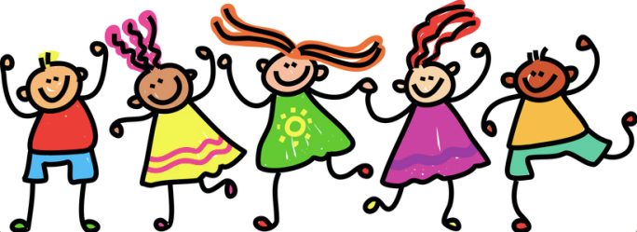

AIMS of the CPD
I will try to break down each skill and suggest different activities which can be used to carry out the skills. Remember to always be brave enough to adapt or change as you will know the pupils and your class the best. I have devised lesson plans for Key Stage one but for Key Stage two I have given games which can be played to enhance the skills which they should have learnt during their time in Key Stage one. At the end I have also provided resource cards which can be used during your lessons.
It is always important to consider the area and the equipment that you have available to you as this will vary from school to school.
The aim is for the pupils to learn some new skills whilst having fun in the process. Don’t be afraid to stretch the more able pupils and always give the pupils plenty of encouragement. I find by stretching the more able pupils will help with their behaviour as they are being stretched and tend to be more focused. This can be achieved by introducing differences in the equipment, space or introducing conditions within the skill/game.
You will always find some pupils whom you teach find their physical ability more challenging than others but remember to always praise those and this should help them to adopt a positive attitude towards physical activities.

Slide 4
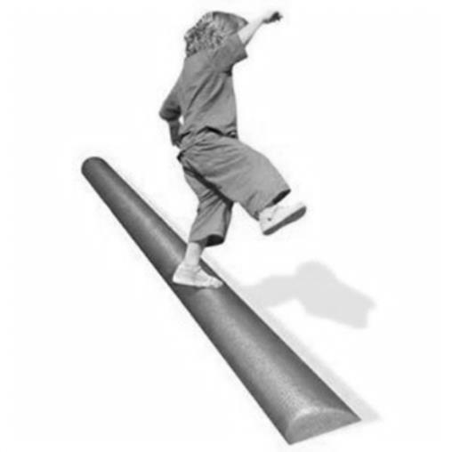
FUNdamentals of Movement
Balance; a state in which the body remains reasonably steady and stable.
Centre of gravity
Counter balance
Core Strength
Base of support

Slide 5
Key Stage 1-Multi-Skills www.hKey Stage 1-Multi-Skills www.healthyheroes.co.uk Lesson: 1/6:- Balance Time: 45 - 60 mins
Main Learning Objectives: For the children to explore static balancing and understand the concept of bases. Resources: Spots, cd player, lively music, whiteboard (to write down letters and numbers if needed) Warm up [5 mins] Beans Call out different types of beans: jumping beans, children jump; runner beans - run; green beans - tall thin bodies; broad beans - still and wide; jelly beans - shake; baked beans - lay flat on the floor; French beans - children call out "Oh la la. Exploring Bases Ask the children to lie on the floor on their backs with their hands by their sides. Explain that they have no chance of falling over they have a lot of their body on the floor. Ask the children to sit up. Lightly push a child to demonstrate that they have a smaller base and therefore less balance. Finally ask the children to stand up. Explain that even though people walk around on two legs we have a very small base and are not as balanced as animals that walk around on four legs. Ask the children to impersonate animals that walk with four legs.

Slide 6
Balancing Games [30 mins] Balancing Statues • Spread some throw down spots in the playing area. Make sure there are enough for each child. • Play some lively music (or on your whistle) children move around the spots using a range of fundamental movements (walk, jog, hop, side slide). When the music stops children, find a spots and perform a balance. Different balances to use: - stand on one leg; stand on one leg-write name with other foot, balance on bottom, and back.
Body Points
Ask the children to demonstrate balancing on different numbers of body parts. This may require some demonstration. Give the children numbers between 1- 4 and ask them to perform balances using that number of body parts. Pick particularly successful students to demonstrate.
Play some lively music (or on your signal) children move around like particular animals (let the children pick their favourites. When the music stops call out a number between 1 and 4. Children, find a spot and perform a balance.
Letters/Numbers
Give the children a letter or number to make with their bodies. Some children may find this easier if you write the letter/number for them.
Extension- Children can make letters/numbers in pairs. In groups children can make words or 3-4 digit numbers
Extension- Pick the same number and ask them to find different balances.

Slide 7
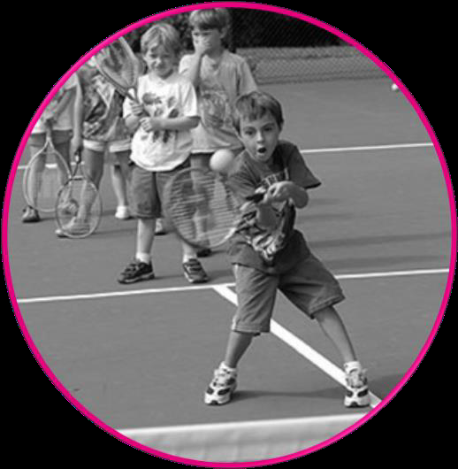
Co-ordination; skilful and balanced movement of the body to produce an action or force.
Mental organisation
From the centre out
From the head down
Kinematic chain

Slide 8

Key Stage 1-Multi-Skills www.healthyheroes.co.uk Lesson: 2/6- Co-ordination: Movement (Fast Feet) Time: 45 - 60 mins Learning Objectives: To combine a number of co-ordination drills using upper and lower body movements Resources: Speed Ladders (or markers) , CD player lively music
Warm up [5 mins]
Body Spots
Place spots around playing area. Play some lively music. Children jog, hop, and skip around the
spots. When the music stops the teacher calls out a body part e.g. shoulders, knees, hands, feet,
2 hands etc. Children must make contact with that part of their body on the floor. Quickly call out
lots of body parts in succession to make in fast and enjoyable at the end.
Ladder Drills [15-20 mins]
Ladder Activities: Split children up into 4 groups. Start with basic movements through the speed
ladders.
Stand to one side of the ladder-run through with one foot in each square
and one foot out. Work on other side around the cone.

Slide 9


Ladder drills
Run through the ladder one foot in each square-knees at 90° with arms to aid movement.
Run through the ladder 2 feet in each square.
Bunny hop through ladder
Ensure children run on the balls of their feet (quiet feet). Make sure children realise that
the drills are not a race and if they knock the ladder or cone they need to slow down.

Slide 10
Co-ordination Games [25mins] Pirates Treasure
One person at time performs a movement
down the ladder (over the bridge). They collect
one piece of their coloured treasure .e.g. a
bean bag. Once they have returned to their
group, the next person starts. Make sure they
perform the drills correctly and do not rush.
Extra treasure can be given to the team who
have the best technique

Slide 11
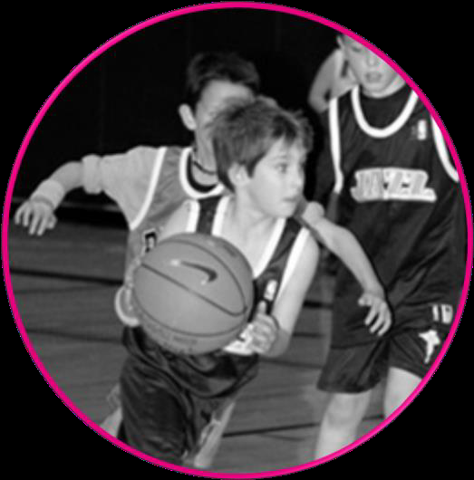
Speed; control of the body and its parts in a dynamic environment Agility; ability to move quickly and efficiently start, stop and change direction and speed whilst maintaining stability
Change direction
Start-stop efficiency
Change speed
Change planes

Slide 12
Key Stage 1-Multi-Skills www.healthyheroes.co.uk Lesson: 3/6- Co-ordination: Aiming and Timing (Hand/Eye) Time: 45 - 60 mins Main Learning Objectives: To aim accurately using a variety of balls and equipment. To time their running so as to stop/intercept the path of a ball. Resources: Balls (variety of sizes), bean bags, hula hoops. Markers, floor target (optional) Warm up [5 mins] DVD Player Children respond to the following commands: Play - walk around the hall. Fast Forward - run. Rewind - walk backwards. Pause - stand perfectly still. Stop-sit down as quick as you can. Eject - jump up and down, Slow motion-move very slowly with big movements
Timing Drills [10 mins] Travelling
Ball Rolling: In small groups children line up one behind the other. One the teachers command
they roll a foam or other soft ball chase it and then stop it using it different ways suggested by
you and the children (e.g.- with foot, sit on it, with head, run around it three time etc...) Ask the children to work in groups and come up with as many ways of stopping the ball as they can in 3 mins.

Slide 13
Aiming and Timing Circuit [25 mins]
Aiming and Timing Circuit: Split the children up into 5 different groups (or keep the same
groups as above). Demonstrate, then rotate around the following activities :
1) Skittles- Set out 10 cones like in ten pin bowling with 10 small foam balls on top. Children
take it in turns to aim a large ball at the cones to see how many they can knock off.
2) Bean Bag in the hoop: Children throw a bean bag into one of three hoops set at varying
distances apart.
3) Children throw bean bags at a wall or floor target. If possible children to keep track of
their scores
4) Children roll a larger hula hoop, partner tries to walk through whilst it is moving
5) Pairs ‘of children stands one behind the other. The front person has his/her legs spread
wider than shoulder width. The child behind rolls the ball through the legs of their partner
who then chases it and stops it.

Slide 14



Lesson: 4/6 Agility- Movement Time: 45 - 60 mins
Main Learning Objectives: To travel in different ways showing a clear transitions between
Moments
Resources: Markers
Warm up [5 mins]
Car Game
Children move around the area according to the gears of a car: 1st Gear= Walk, 2nd Gear = Jog, 3rd Gear Run (on the spot if indoors). Hedgehog=curl up in a ball on the floor, Squashed Hedgehog lie down flat on the floor with arms out stretched. Ask for more suggestions.
[10 mins]
Agility Trails
In four groups the children perform
movements through the cones. e.g.
• Zig zag
• Jumping- 1 foot to 1 foot (hop), 1
foot to 2 foot (hop scotch), 2 foot to
2 foot (bunny hop)
• Running –one foot in each step.

Slide 15


Circle run /chase the ball
Gather the children in a circle. On your
signal one child runs around the outside of
the circle. When he or she returns to their
place the next person goes. Keep going
until every child has ran around circle on
returned to their place. All sit down
together when finished.
Two circles could be used to develop race or could introduce a ball to pass around the circle. Can vary the ball depending upon the ability of the group.

Slide 16

Lesson: 5/6:- Agility- Changing Direction Time: 45 - 60 mins Main Learning Objectives: To travel in different directions (side to side, up and down) with control and fluency. Resources: Bean Bags, Hoops (1 green, 1 blue, 1 green, 1 red), Markers
Warm up [5 mins]
Circle Run- As last lesson but children march on the spot while waiting. Play lively music
for the children to march along to.
Agility Games
Collect the Cones
Spread as many cones/spots as the area will allow. On your signal children collect as many
spots/cones as they can. Next specify a colour to see who can collect the most.
Split the children up into four equal groups. On your signal the children collect the bean bags one at a time and place them the correct hoop.
They all sit in a line once finished. Each group could be timed and they must beat their score on their next go.

Slide 17
Flush
Give a set number of children a bib to wear. Children try to run from the children with the bib. If they are tagged they have to pretend to sit on the toilet and wait for a free child to release them by pushing their arm down and shout. Can vary the size of the area and the amount of children wearing a tag to make it harder. Make sure the area is safe from any hazards.

Slide 18
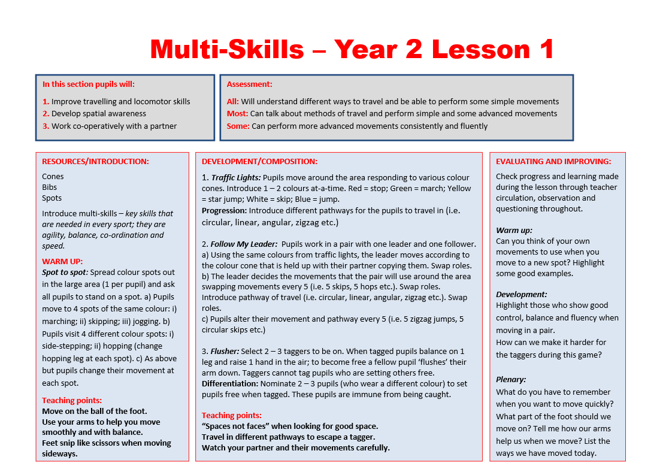

Slide 19
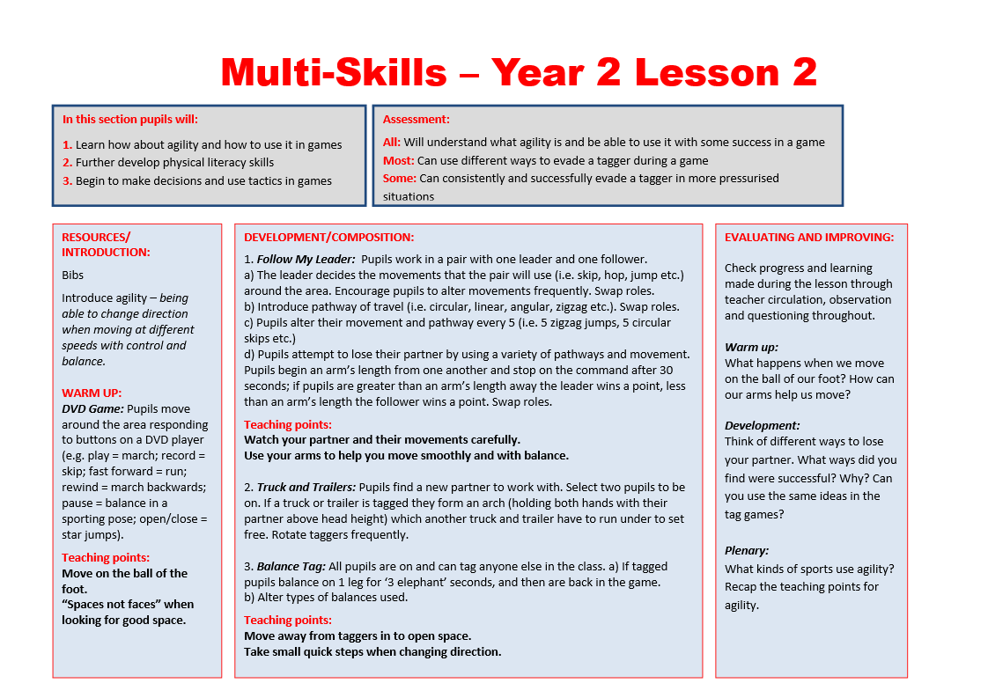

Slide 20
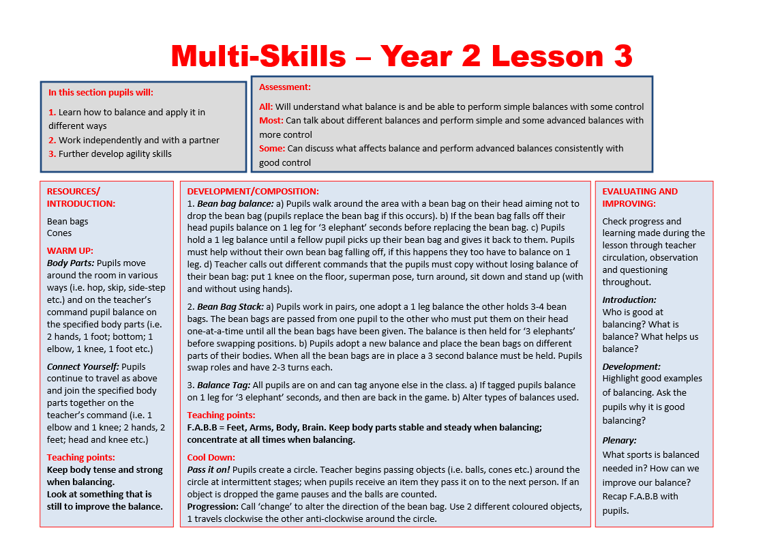

Slide 21
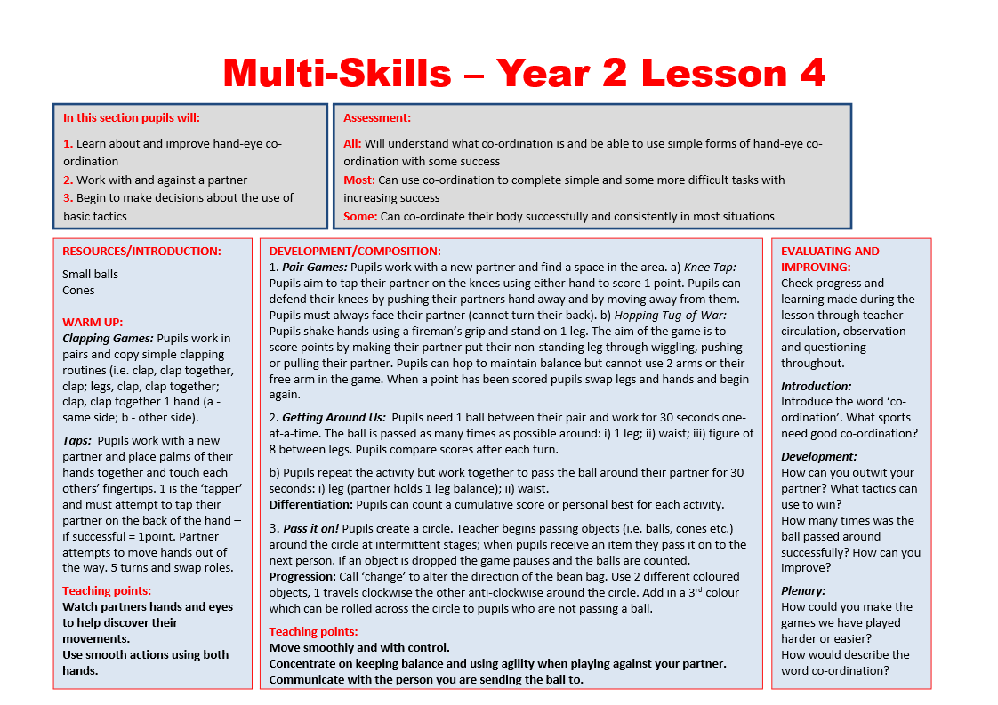

Slide 22
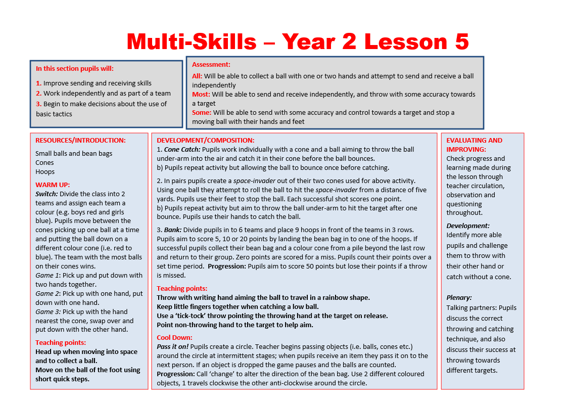

Slide 23
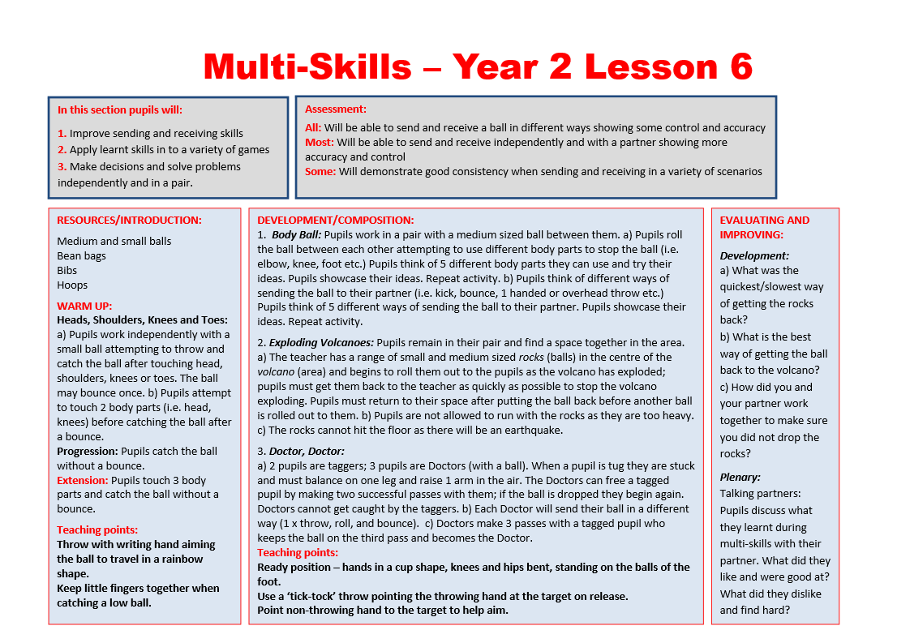

Slide 24
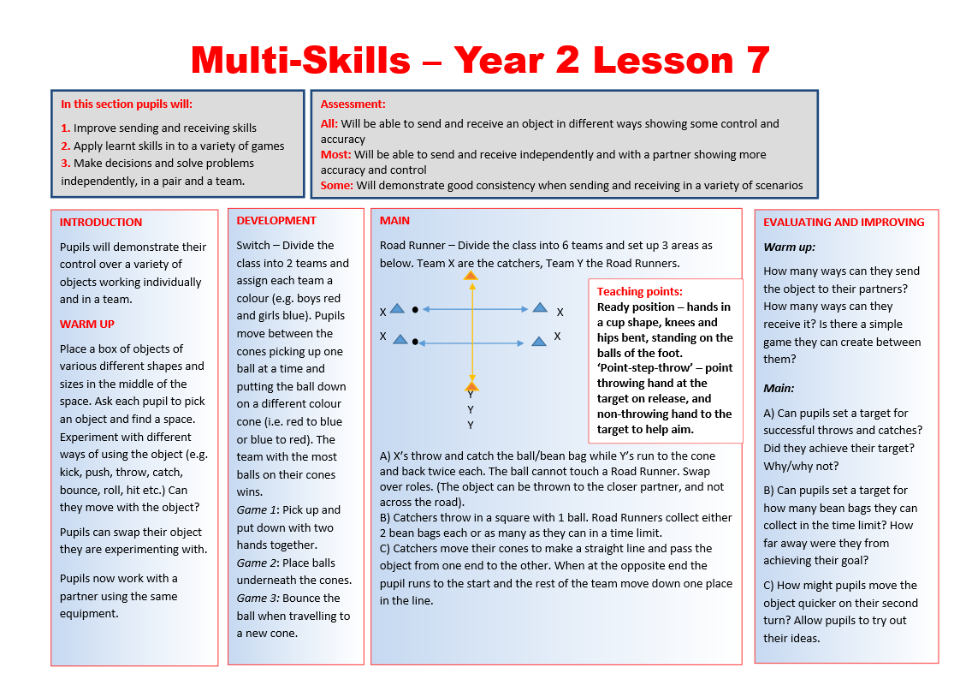

Slide 25
Key Stage 2 game based activities
In Key Stage two you can adapt the lesson plans for Key Stage one but make it more game specific. The participation in team games, developing simple tactics for attacking and defending will stretch all pupils. I always put pupils of equal ability together to play against other players of similar ability as pupils get frustrated with pupils if they feel they are not of the same ability. Differentiation is easy to adapt and all pupils are happy as they are working at their ability and against pupils of similar ability.
Students would have to play in a small sided team and play directly against another team. This would allow students not only an opportunity to apply their skills in pressure situations but also to adapt them and make choices about what skills to use in particular moments. The themes you could choose to focus on are;
Transition
Changing the angle of attack
Recognising Patterns
Strategy
Split attack
Ready Positions
Arriving at the correct moment

Slide 26
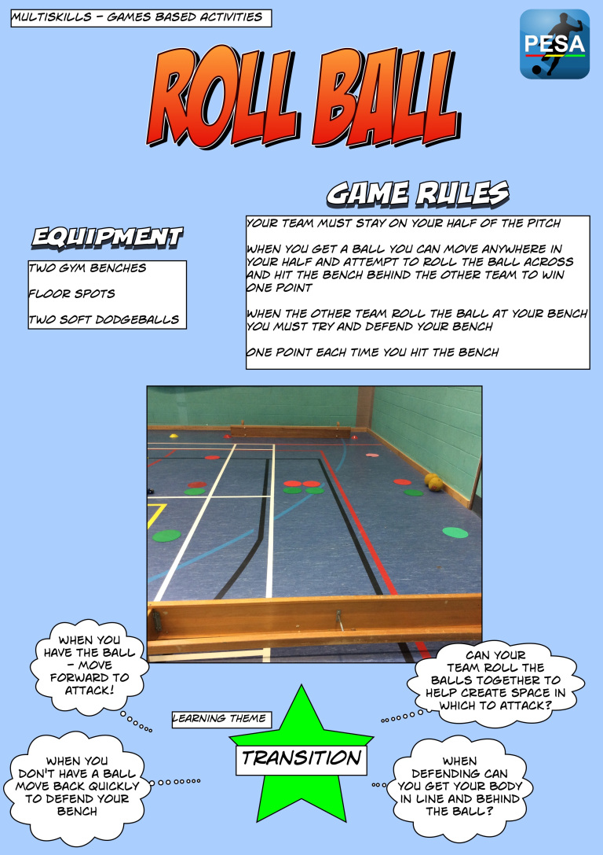

Slide 27
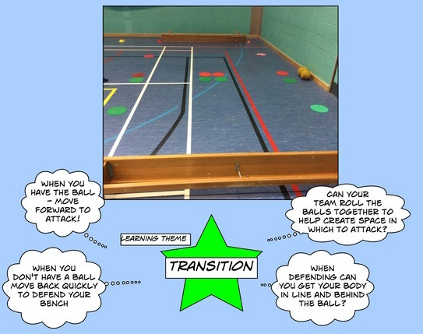

Slide 28
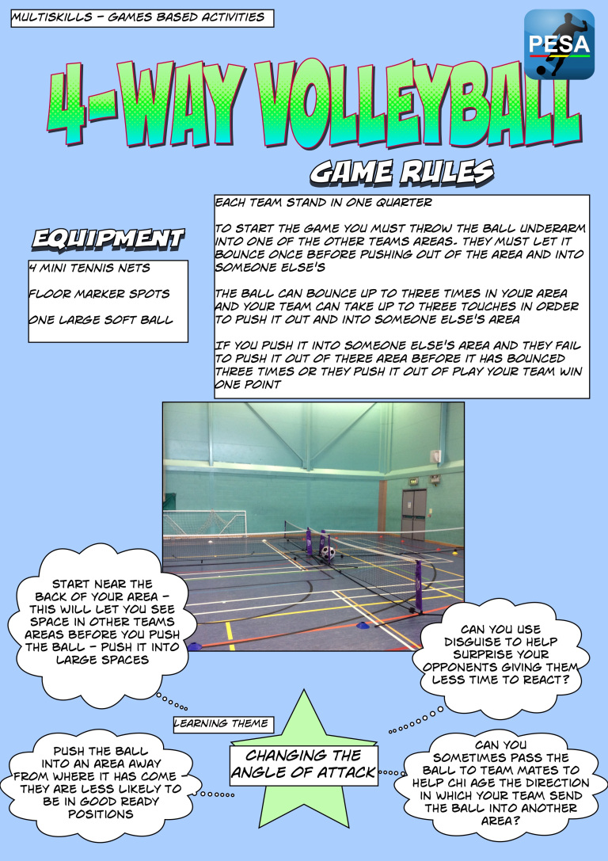

Slide 29
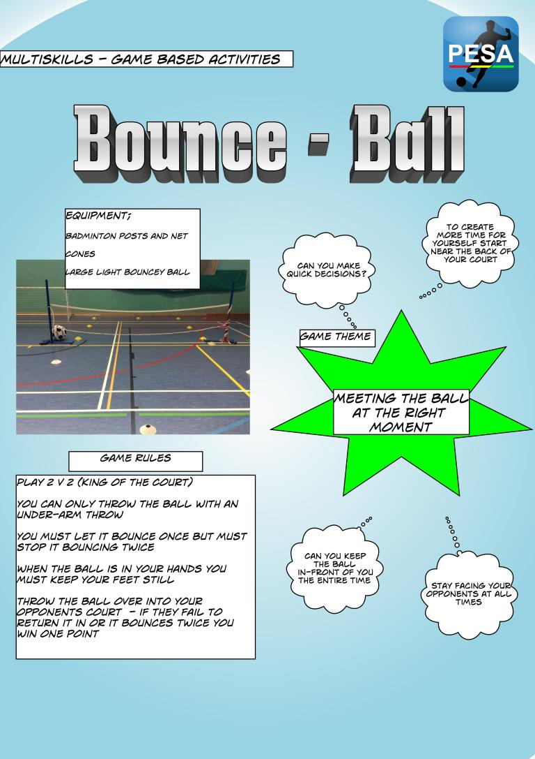

Slide 30
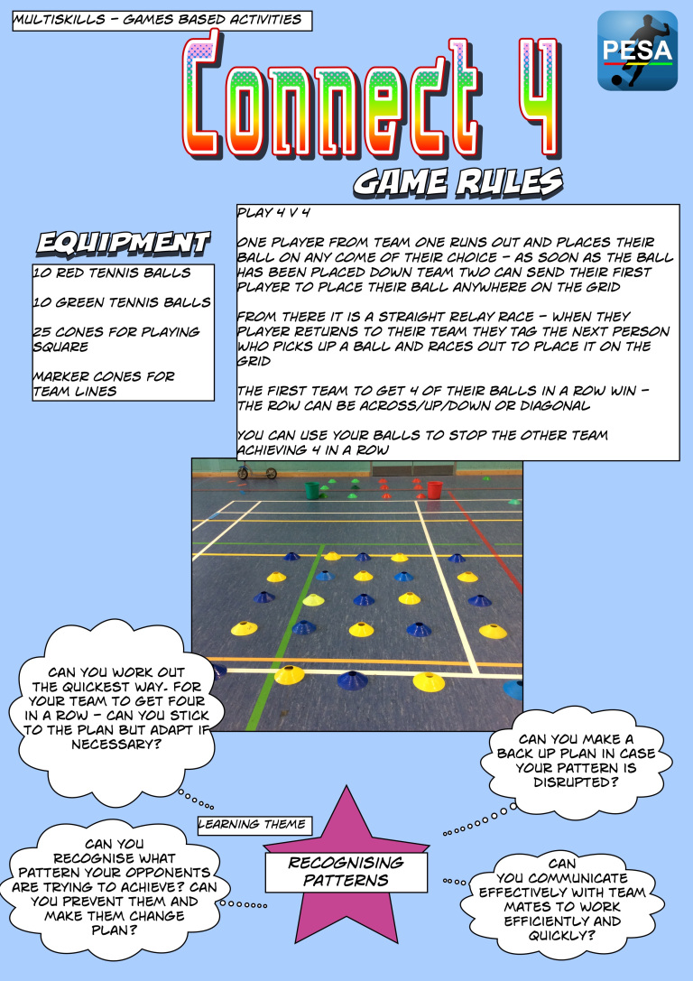

Slide 31
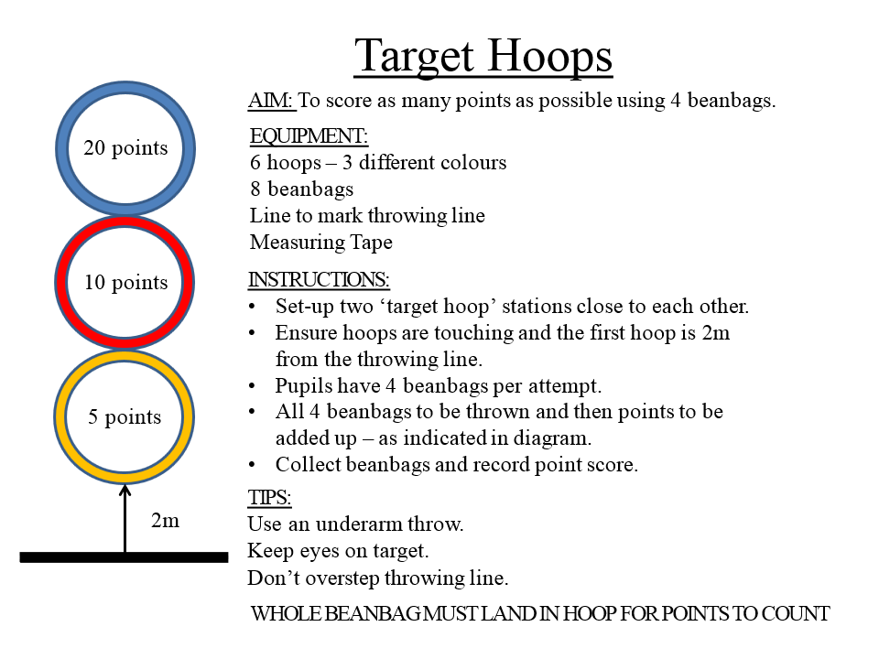

Slide 32
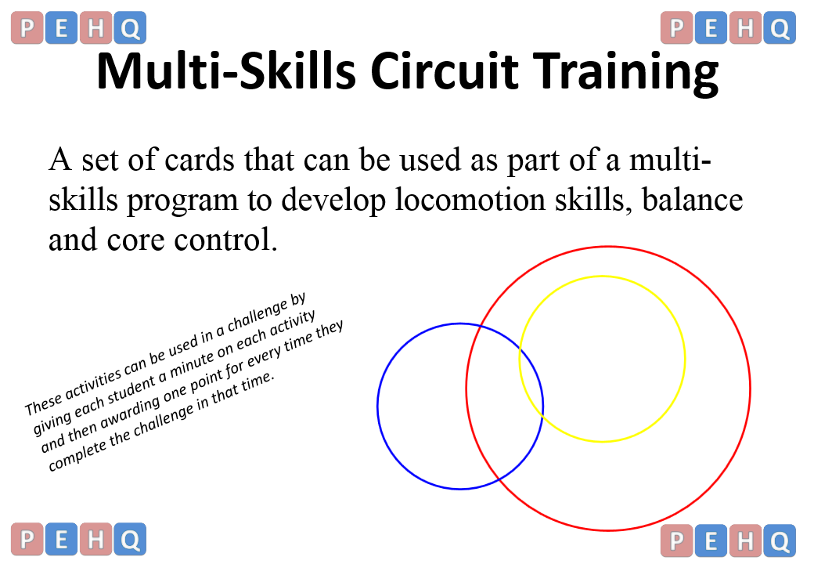

Slide 33
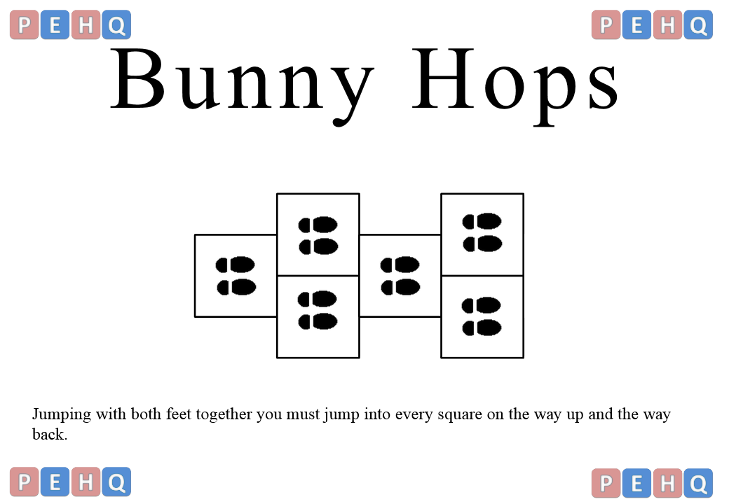
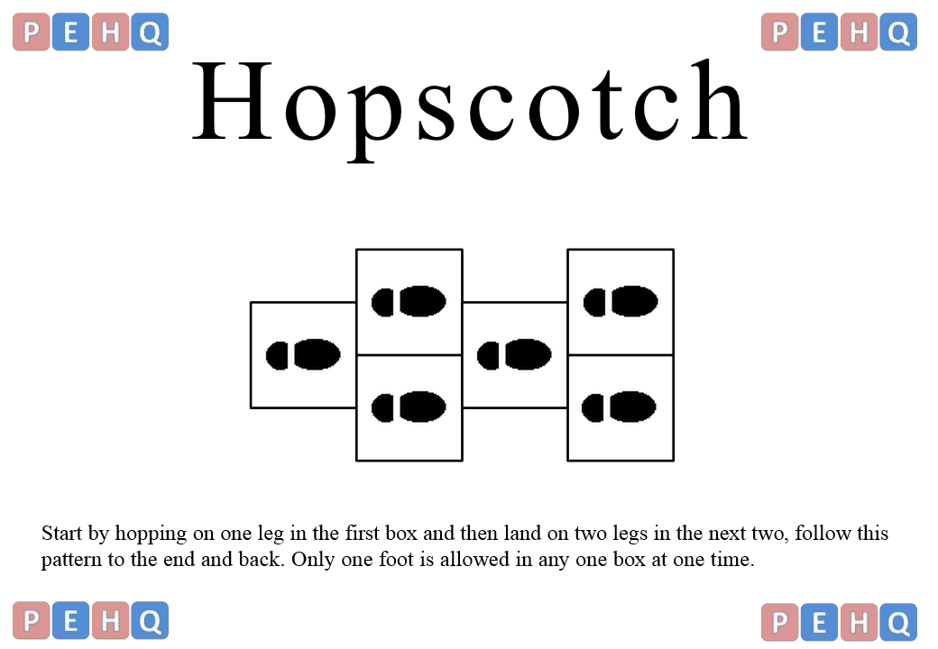

Slide 35
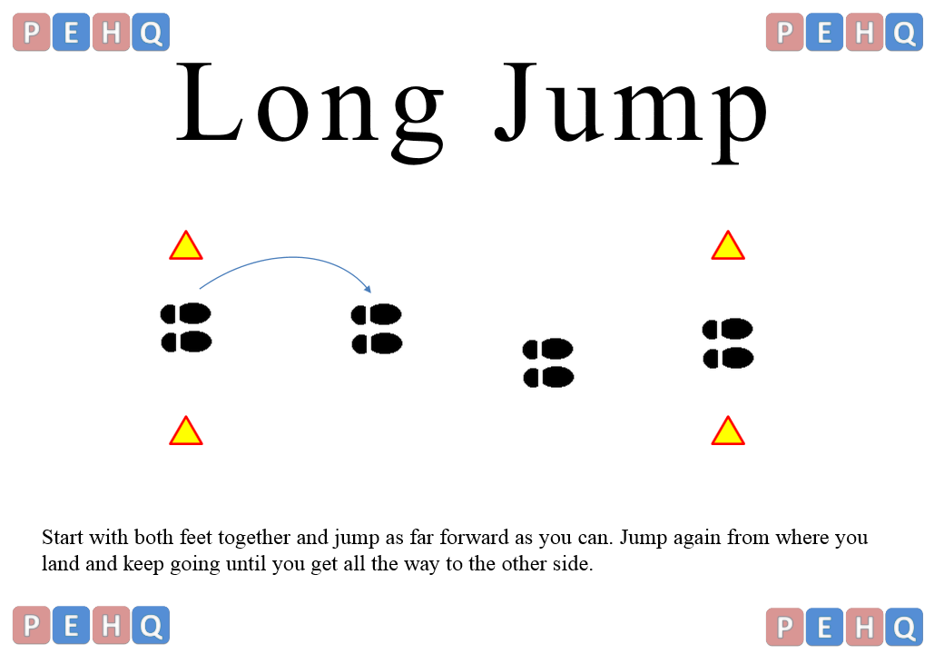

Slide 36
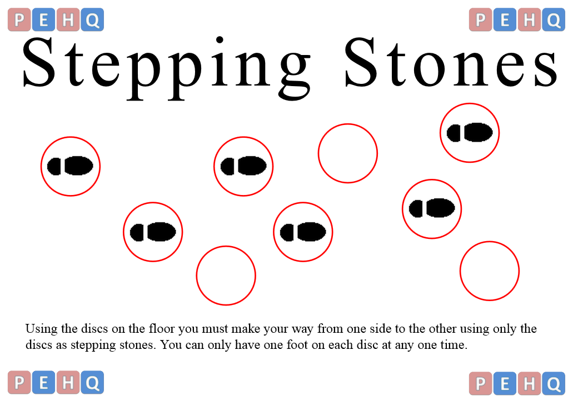

Slide 37
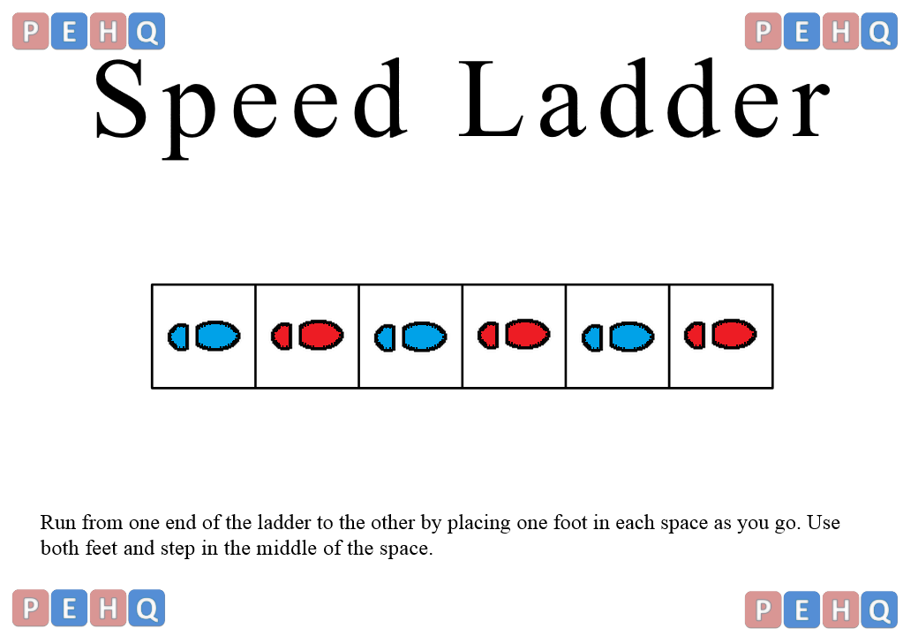

Slide 38
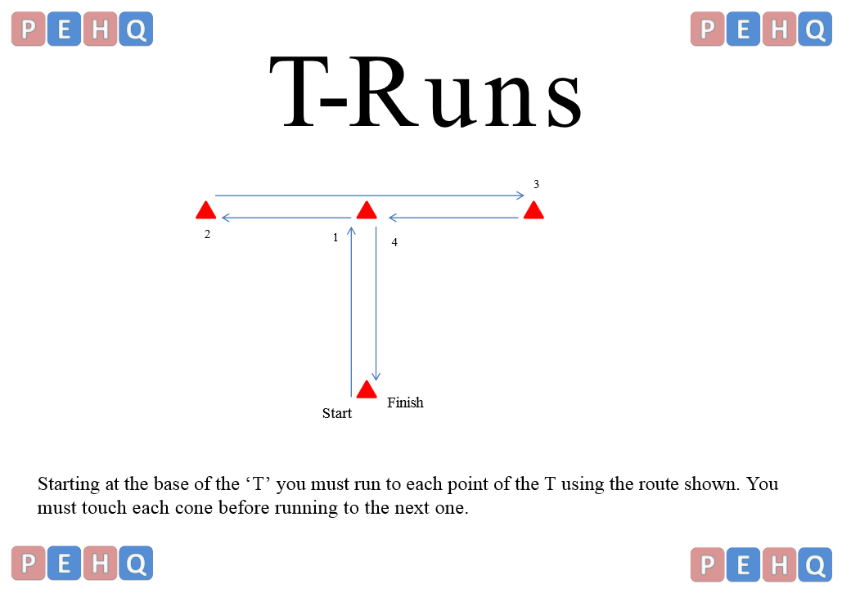

Slide 39
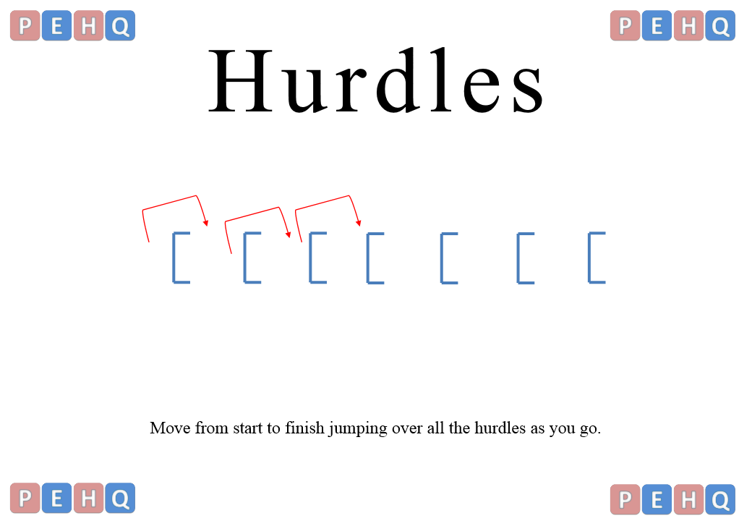

Slide 40
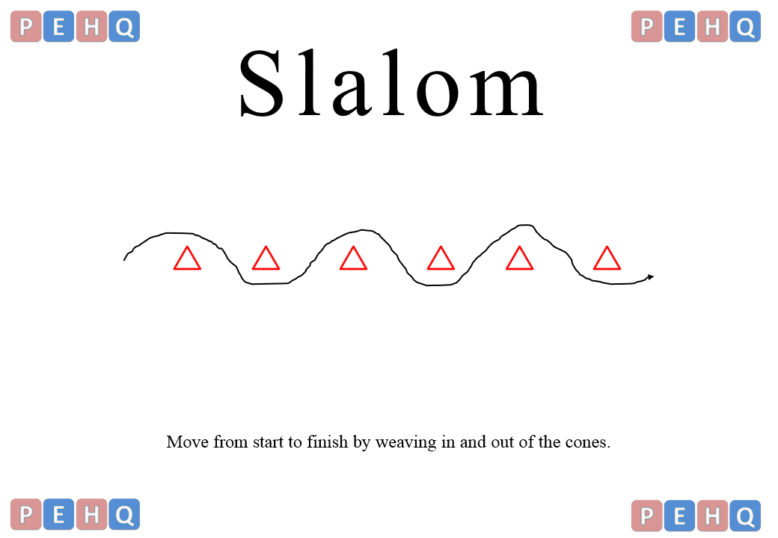

Slide 41
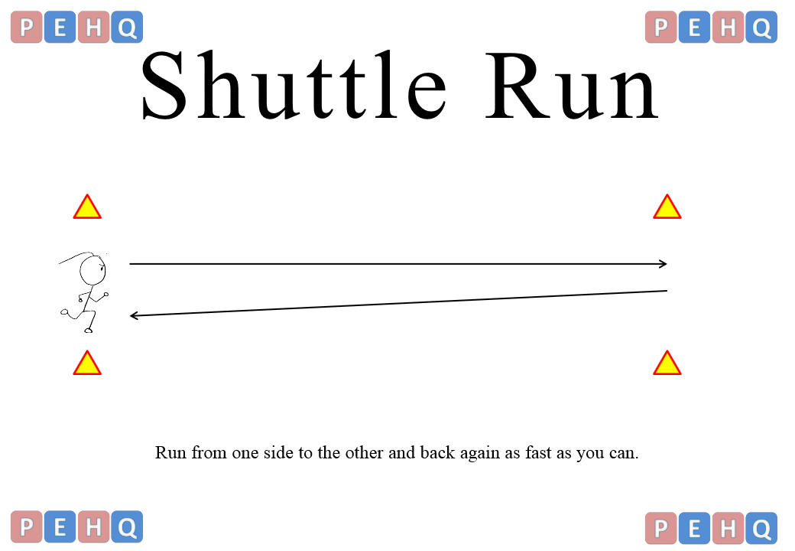

Slide 42
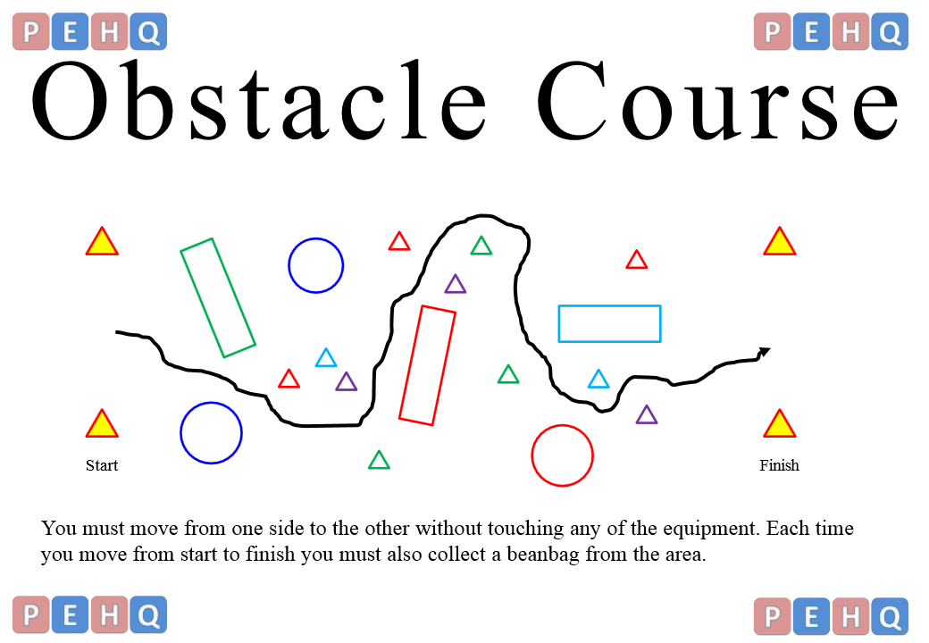

Slide 43
Link for sites where I got resources from
https://www.sasp.co.uk/uploads/multiskills-year-5-lessons-1-12.pdf
https://www.tes.com/teaching-resource/multiskills-station-cards
https://sportscotland.org.uk/.../multi-skills/multi-skills-course-resources
https://binspireduk.co.uk/.../2017/08/Year-2-AT-1-Multiskills-Unit.pdf

